Slide 1
Fall Detection: Progress Presentation
Abbos Aliboev

Slide 2
Table of contents
01
02
03
04
Motivation
System Overview
Dataset
Pose Completion + CNN + TE
05
06
07
08
Model Architecture
Comparative Table
Develop. Progress
Conclusion

Slide 3




Motivation
Construction sites are dangerous
– Falls are the No-1 cause of death on construction sites
– Many falls go unseen — no one reacts in time
Real-time detection saves lives
– Stop machines, call help immediately
Why vision-based?
– Cameras are cheaper, always on
– Sensors are limited, uncomfortable
– Challenge: occlusion & speed

Slide 4
Problems in Existing Work
1
Sensor-based systems: expensive, non-scalable
2
Old vision models: slow, not real-time
3
Occlusion not handled
4
Pre-fall not predicted

Slide 5

Our Objective
1
Real-time detection
2
Handle occlusion
3
Predict fall before it happens (Pre-fall)
4
Estimate time-to-fall (regression)
5
Edge-compatible (Jetson, etc.)

Slide 6
System Overview Diagram
3
4
Pose Completion
TCN
2
5
YOLOv8
pose
Transformer
6
1
Frame
Classification + Regression

Slide 7
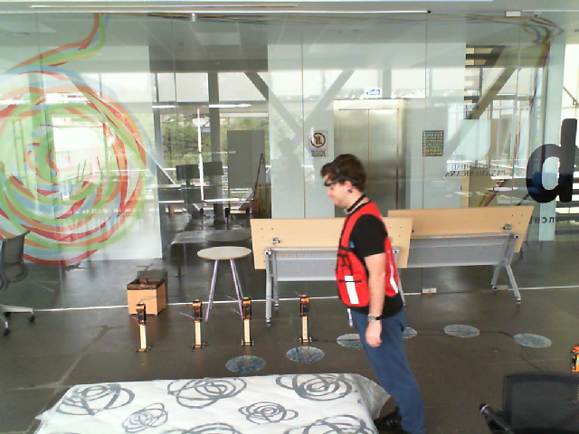
Dataset Use
UP-Fall - only frames
Custom video dataset
Publicly available
17-folders, one per subject:
11-subfolders, one per activity:
Multiple people in a frame (multi-person scenarios)
PPE gear (helmets, vests, etc.)
Various fall types with occlusion
Pre-fall behavior recorded explicitly
1.5BN People
People who get and Engineering degree around the world
553MN People
People who live in underdeveloped country

Slide 8
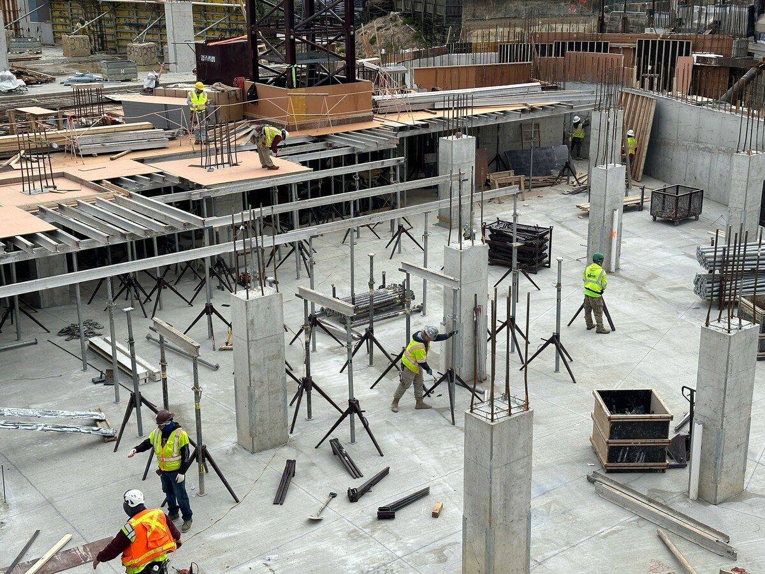
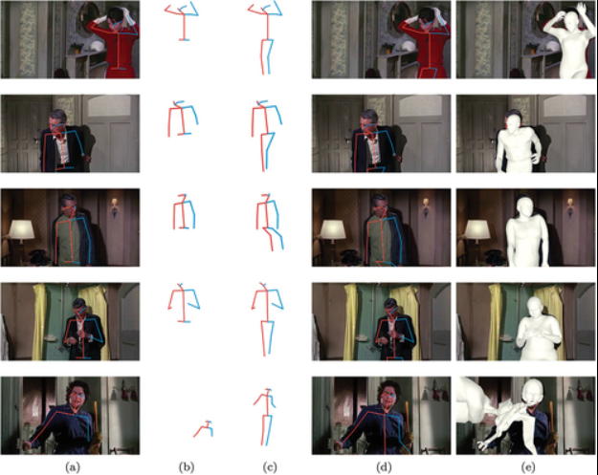
Pose Completion
Problem: Occlusion = missing joints Solution: MLP or AutoEncoder fills missing keypoints Lightweight for real-time

Slide 9
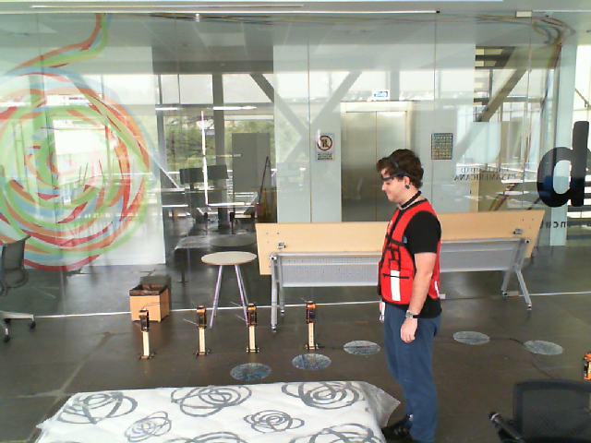
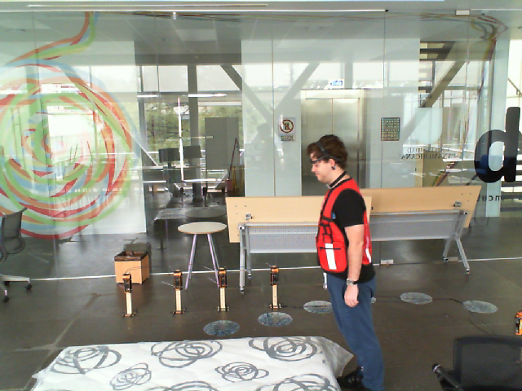
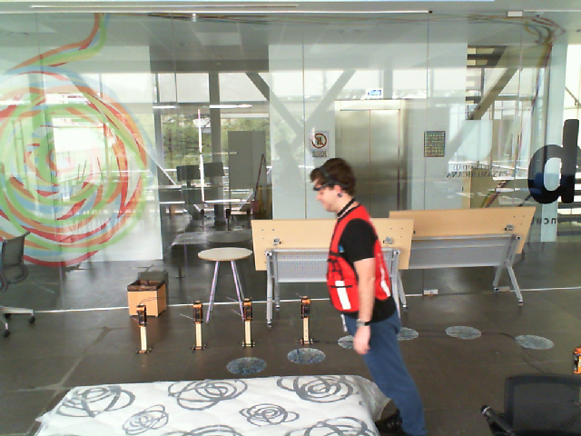
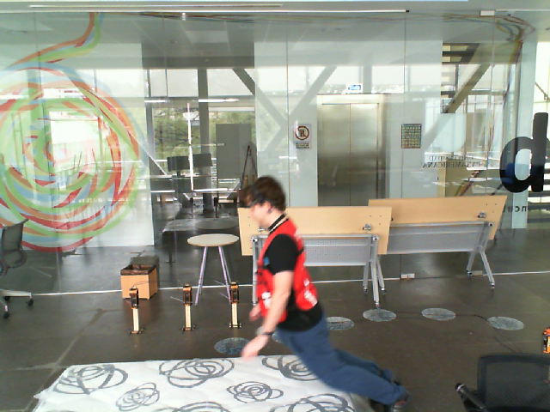
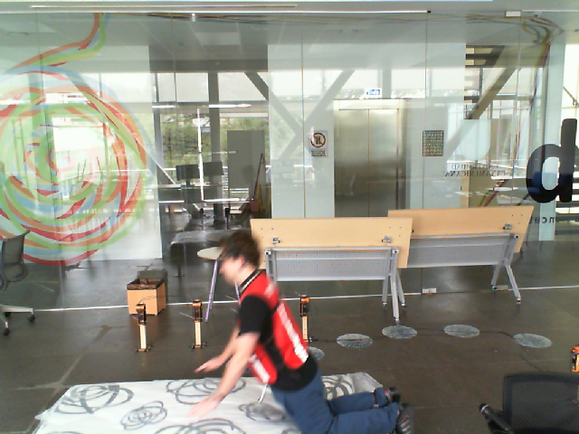
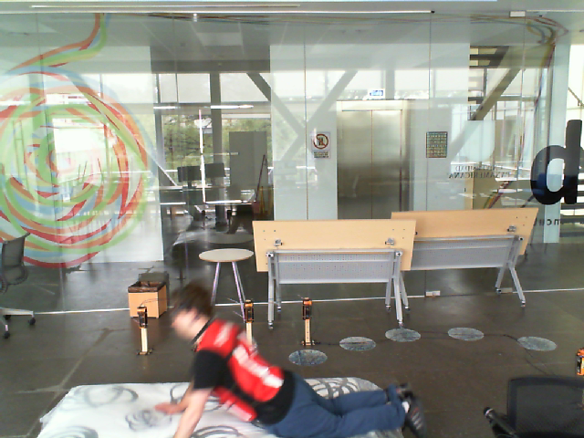
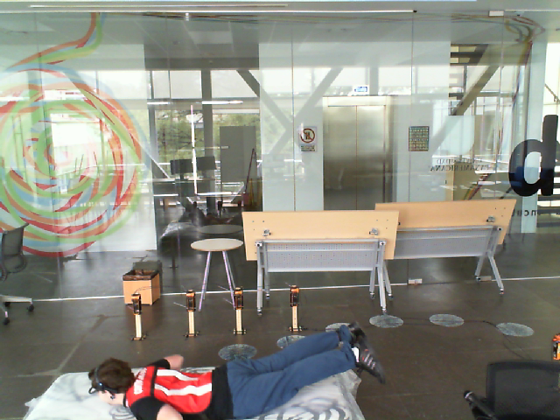
Sequence Modeling (CNN)
Detects short-term motion patterns
Works on a sliding window of pose vectors
Very fast – ideal for real-time systems
Frame 1
Frame 2
Frame 3
Frame 4
Frame 5
Frame 6
Frame 7
Used as a motion window for CNN

Slide 10
Temporal Attention (Transformer Encoder)
Captures important frames in time
Focuses on motion before fall
Efficient attention head
Frame 1
Frame 2
Frame 3
Frame 4
Frame 5
Frame 6
Frame 7

Slide 11
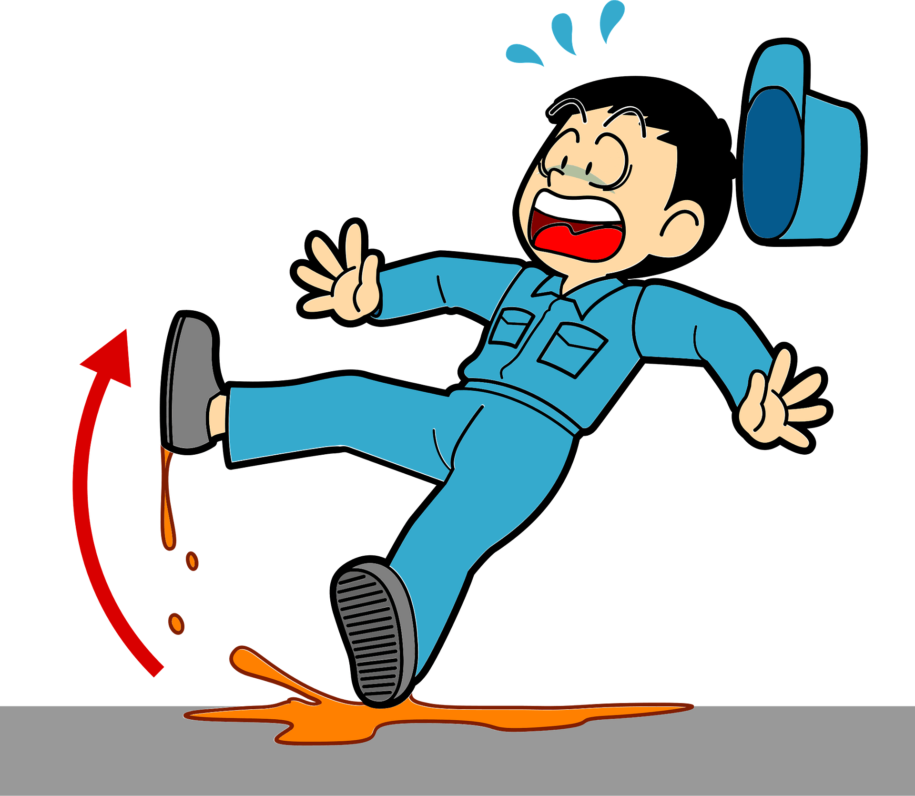
Dual Output Head
Output 1 | Output 2
Classification | Regression
Fall / Pre-fall / No fall | Time-to-fall in seconds (ttf = 1.45)
ttf = 1.45
Fall

Slide 12
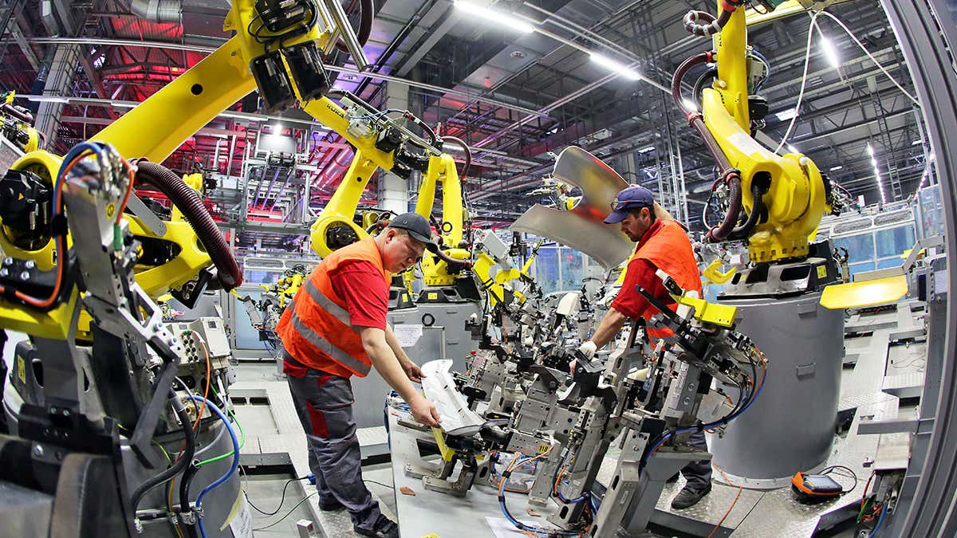
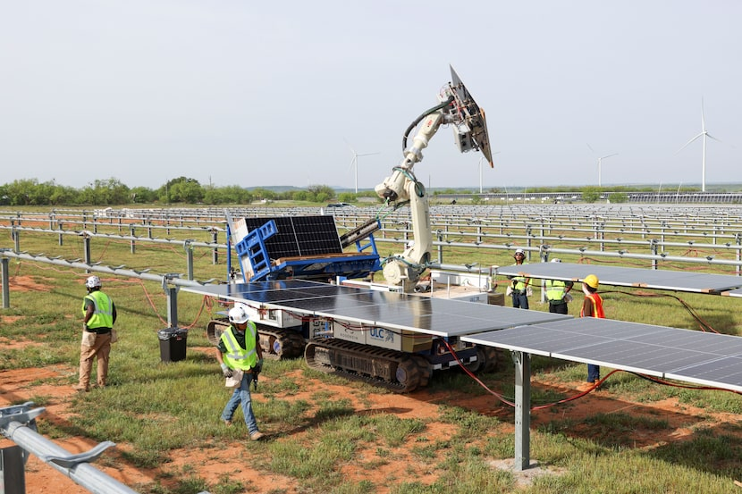
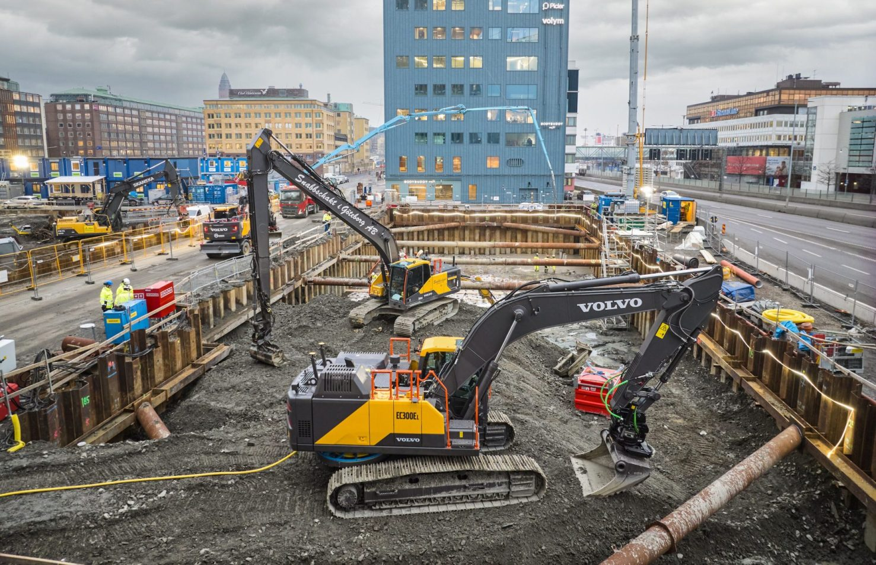
Dual Why Is Regression Important?
Regression predicts "how many seconds until a fall occurs” - *(e.g., “1.7 seconds to fall”)
Enables early warning systems: alarm, drone, emergency response
Helps take action before the actual fall happens
Offers a precise estimate of how close the person is to falling

Slide 13
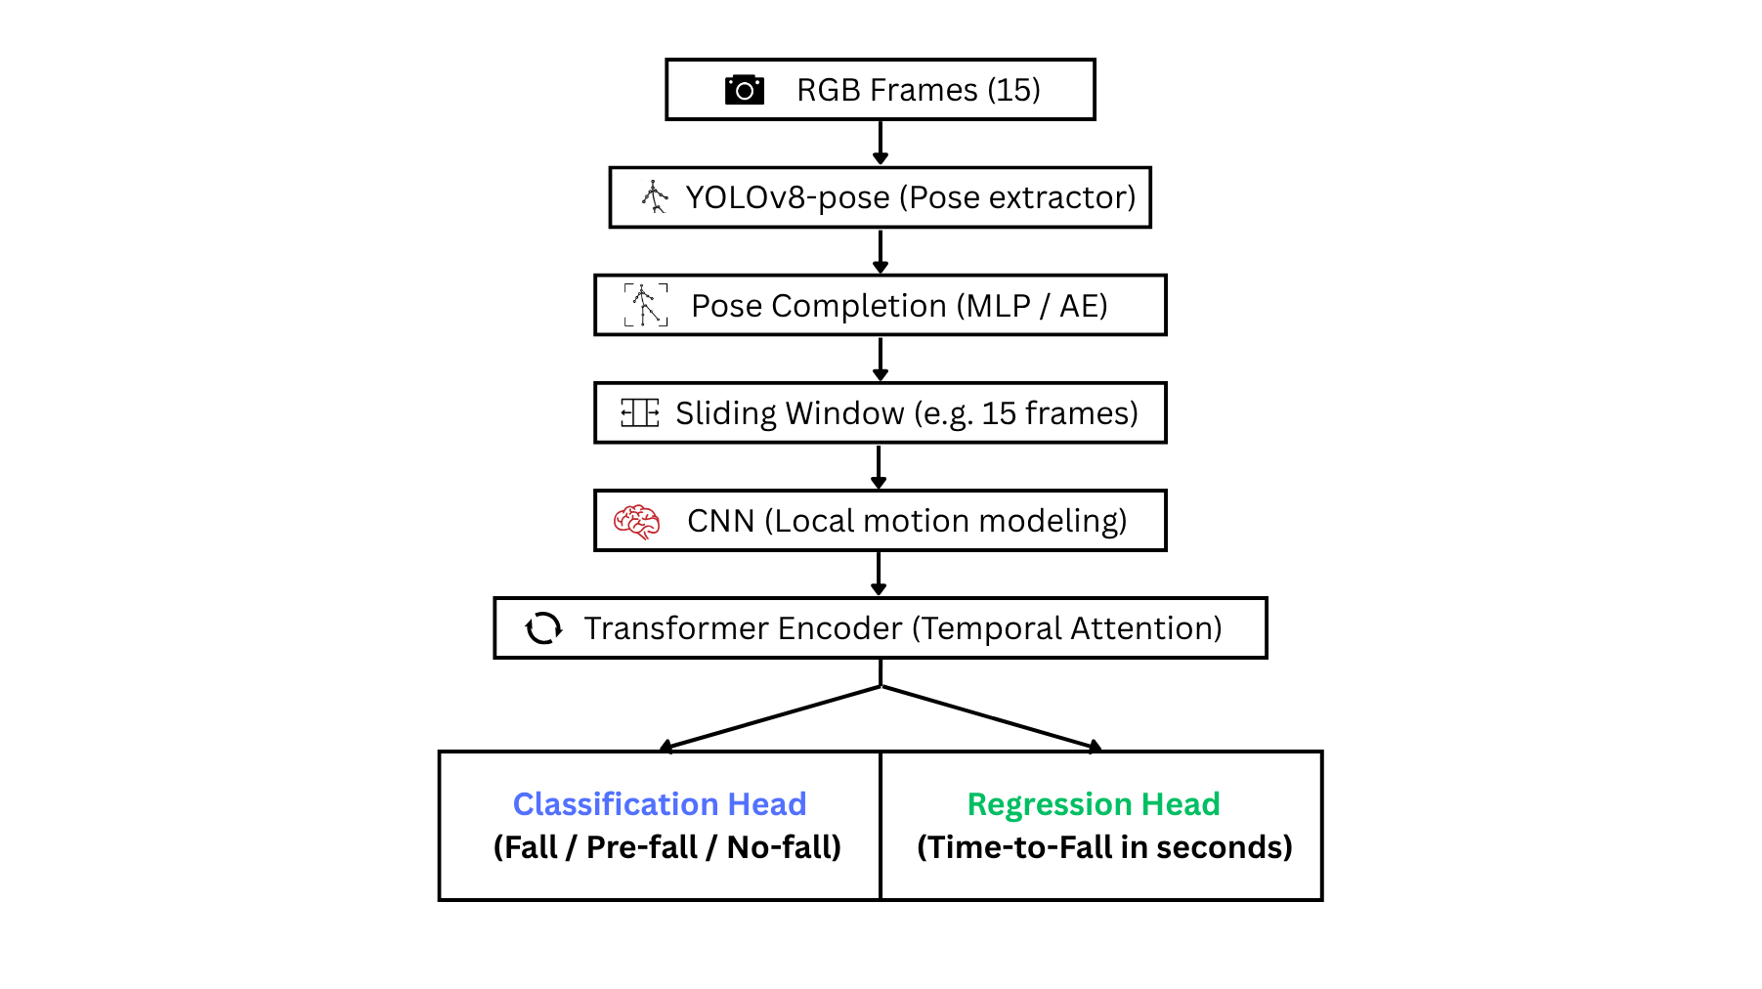
Model Architecture Overview

Slide 14
Comparative Table
Model | Occlusion | Pre-fall | Regression | Attention | Real-time
YOSAP | ❌ | ✅ | ❌ | ❌ | ❌
TCNTE | ❌ | ❌ | ❌ | ✅ | ✅
TST | ❌ | ❌ | ❌ | ✅ | ❌
Ours | ✅ | ✅ | ✅ | ✅ | ✅

Slide 15
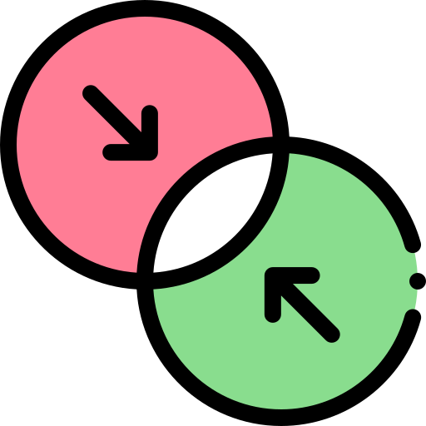



Model Innovation Summary
First
Combine pose completion + attention + TTF regression
Multiple people
Multi-person ready, real-time capable
3 Stage fall detection
Fall prevention, not just detection

Slide 16
Development Progress
Task | Status
Dataset exploration | In progress (analyzing UP-Fall, reviewing options)
Pose extraction (YOLOv8-pose) | Planned
Pose completion | Studying techniques (MLP, AutoEncoder)
Annotation (Pre-fall, TTF) | To be designed
Model structure comparison | CNN, TCN, Transformer analysis ongoing
Training | Not started
Evaluation | Not started

Slide 17
Technical Challenges
Frame-label alignment
Manual annotation time
01
02
03
Keeping FPS high while adding complexity

Slide 18
Conclusion & Final Thoughts
We proposing a real-time vision-based fall detection system tailored for construction site environments
Our model handles:
→ Occlusion via Pose Completion
→ Short-term motion via CNN
→ Temporal patterns via Transformer
→ Fall risk via Classification + Regression
🛠️ Currently under development – focusing on:
→ Annotation, model training, real-time optimization

Slide 19
Progress Presentation Real-time Fall Detection using Pose & TCN
Abbos Aliboev

Slide 20
Method
Camera (Frame)
YOLO11s Pose Model
(17 keypoint)
Extract (x,y) for keypoints
Preprocessing + Resize
TCN
Software Prediction

Slide 21
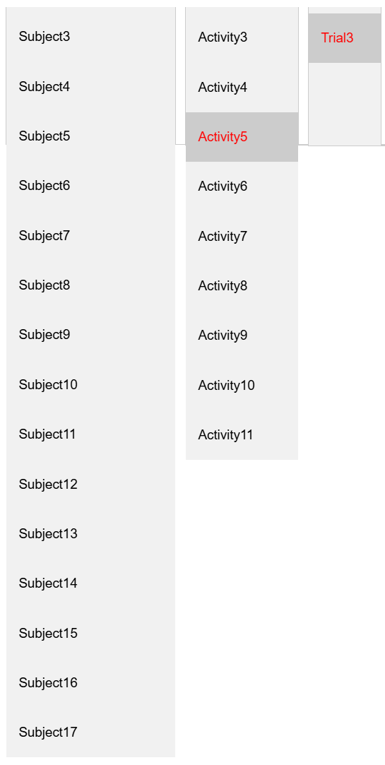
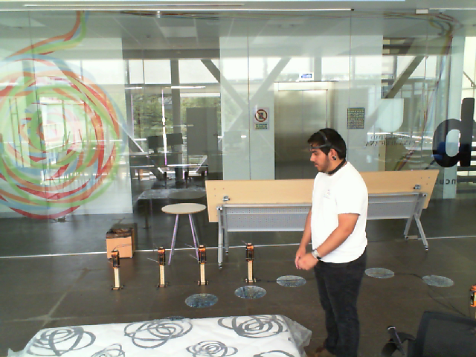
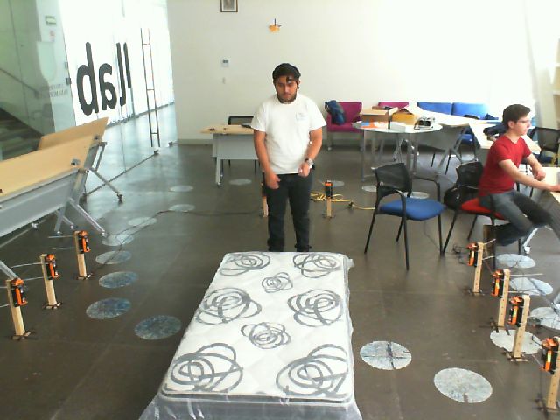
1. Dataset Preparation
FALL-UP DATASET
→ Each activity folder has around 1000 frames.
→ There are over 100,000 frames in total.
→ We selected about 5000 frames from 5 activities.

Slide 22
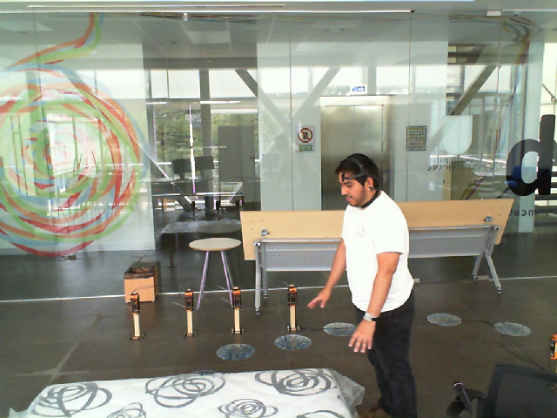
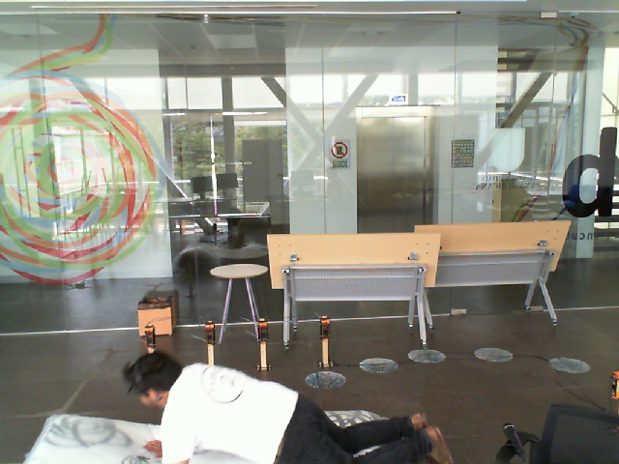
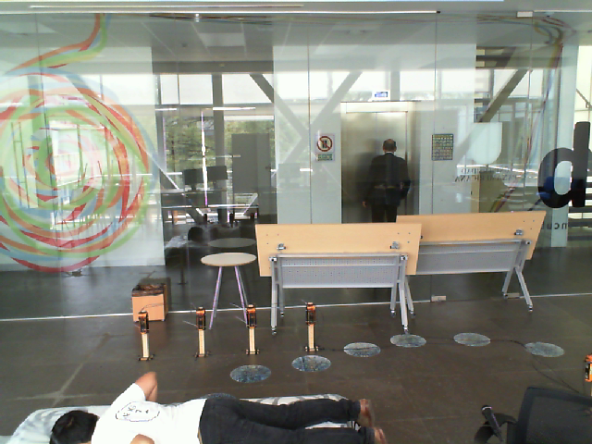
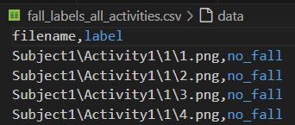
1. Dataset Preparation
Labeled each frame: no_fall, pre_fall, fall
Created CSV with labels per frame
Example:
1 folder - 189 frame
1-15 no-fall
16-25 pre-fall
26-189 fall
no-fall
pre-fall
pre-fall
fall

Slide 23
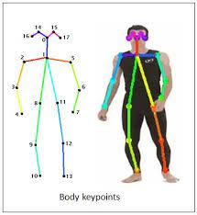
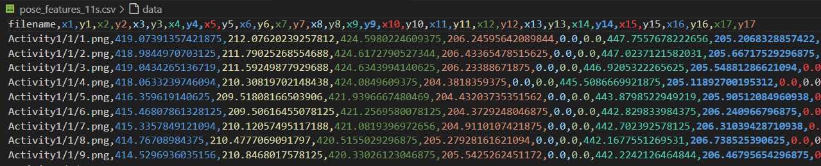
2. Pose Extraction
Used YOLOv11 pose model
Extracted 17 keypoints per frame
Saved pose data into CSV (x1,y1,...,x17,y17)
Used as input features for model
Example:

Slide 24
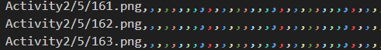
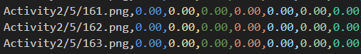
3. Pose Verification & Cleaning
Detected missing poses (zero vectors)
Total missing frames: 105 out of 5665
Marked such frames for cleaning
Ensures clean input for model
Example:

Slide 25
4. Sequence Dataset (Sliding Window)
Created 15 frame sequences with stride=1
Each sequence labeled by priority: fall > pre_fall > no_fall
Total sequences generated: 144,034
Saved to: fall_sequences_priority_label.csv
Example:
= 15 frame
1 sequence

Slide 26
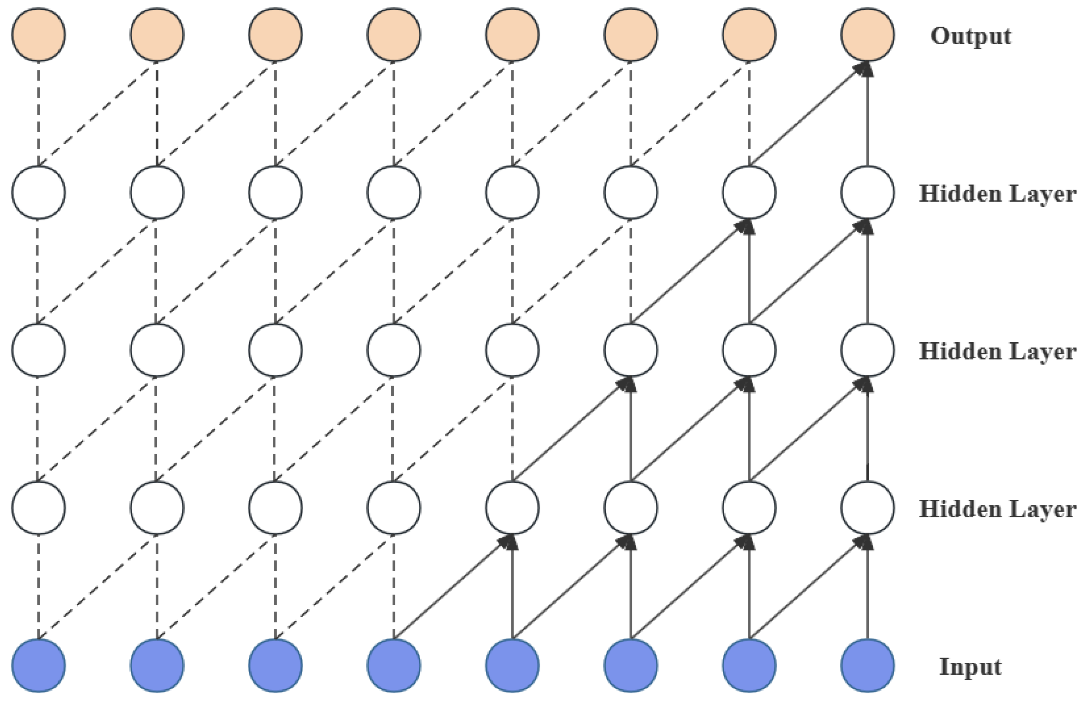
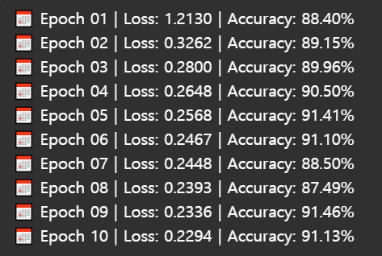
5. TCN Model Training
Trained TCN model with 10 epochs
Input: (15, 34) per sequence
Achieved 91% overall accuracy
Model saved: tcn_model.pth
Results:
Sructure of TCN

Slide 27
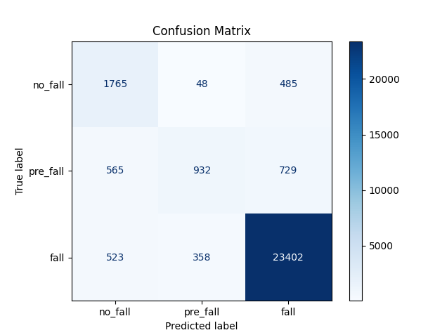
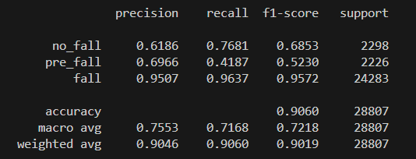
6. Evaluation Results
Class-wise performance:
Fall → F1: 0.96, Precision: 0.95
Pre-fall → F1: 0.57 (needs improvement)
No-fall → F1: 0.70
Next step: Improve pre-fall detection

Slide 28
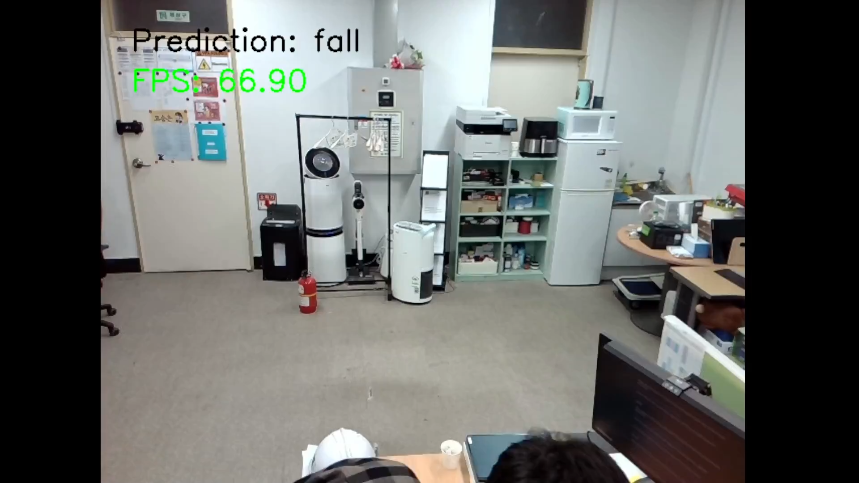
Demo
Web cam Avg FPS 51
If a person stands too close to the camera, it falsely detects a fall

Slide 29
Summary
Successfully built labeled dataset
Performed pose estimation using YOLO
Created temporal sequences for training
Trained TCN model with good performance
Future work:
Improve Pre-fall Detection
Add Person Detection Filtering
Distance-Aware Logic
Pose Quality Assessment
Balanced Dataset
Visual Alert System
Multi-person Fall Detection

Slide 30
Progress Presentation Retrain & BoT-SORT
Abbos Aliboev

Slide 31
Method
Camera (Frame)
YOLO11s Pose Model
(17 keypoint)
Extract (x,y) for keypoints
BoT-SORT
Preprocessing + Resize
TCN
Software Prediction

Slide 32
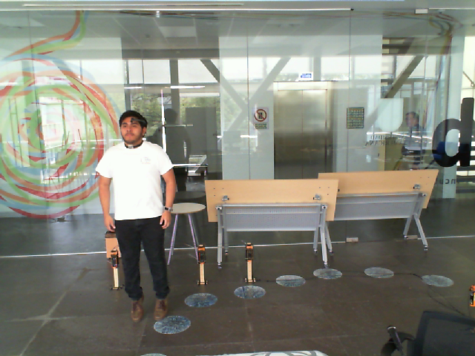
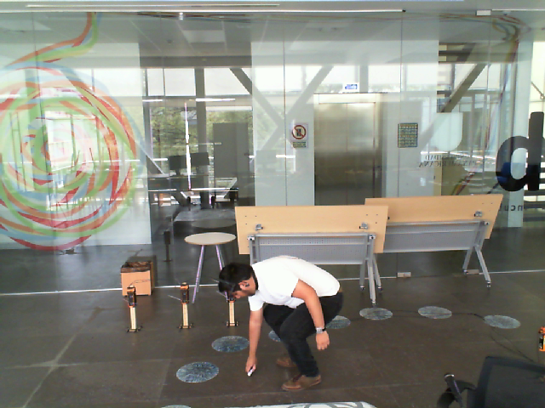
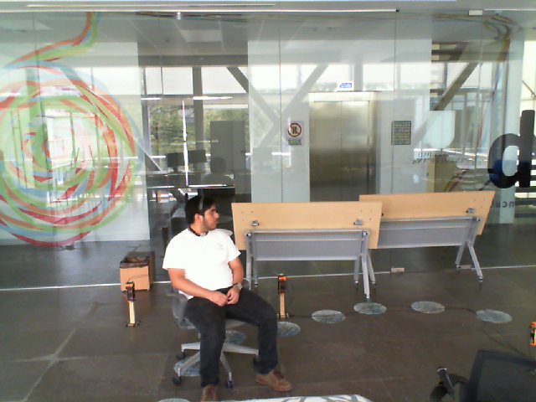
1. Dataset Preparation and Retrain
Labeled each frame: 1) no_fall, 2) pre_fall, 3) fall
Old Dataset
1 folder - 189 frame
1-15 no-fall (15)
16-25 pre-fall (~10)
26-189 fall (160~)
no-fall
pre-fall
fall
New Dataset
1 folder - 46 frame
1-15 no-fall (15)
16-25 pre-fall (~10)
26-46 fall (15-20)
Included no-fall negative classes
Jump
Bend
Sit

Slide 33
1. We switch from .pth to .pt?
Initially, we used a .pth file for our TCN model, but it did not work well
The model gave many wrong predictions
The .pth file contained unnecessary layers.
{"model": model.state_dict(), "in_ch": input_size}
We created a cleaner .pt file containing only:
Loaded without key mismatches
Worked more reliably
Improved the overall accuracy and stability

Slide 34
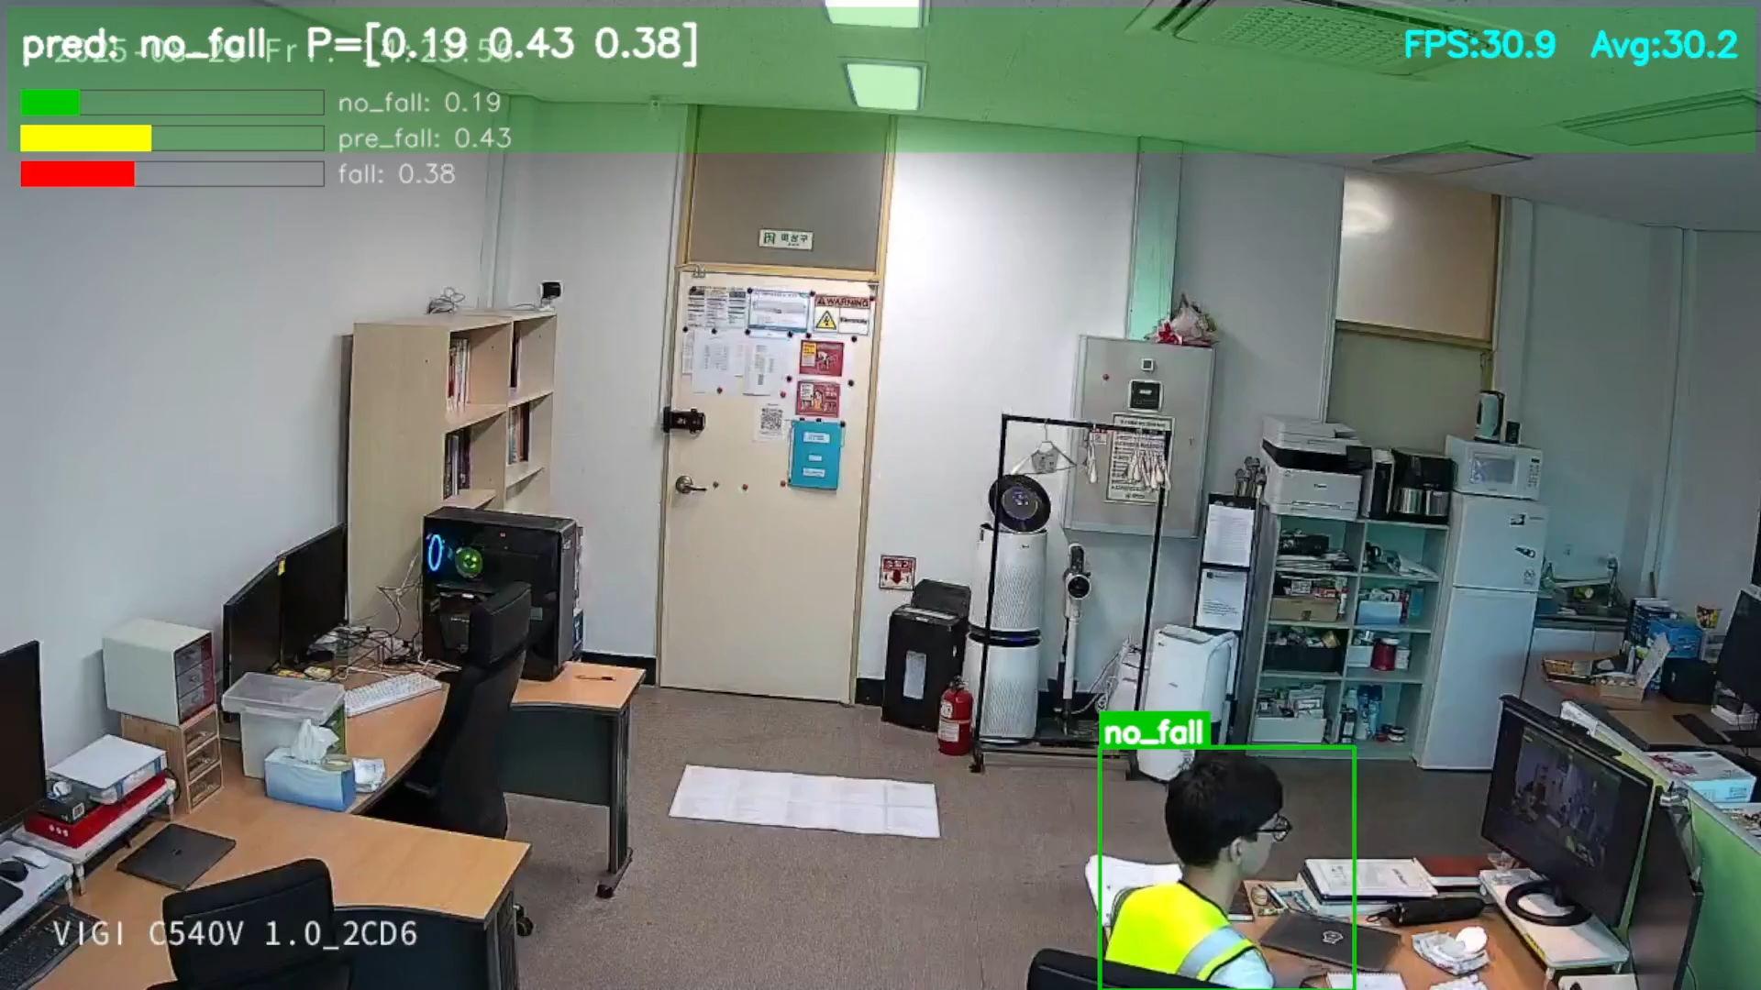
DEMO – 1 camera

Slide 35
Progress Presentation Optimization (Multicam)
Abbos Aliboev

Slide 36
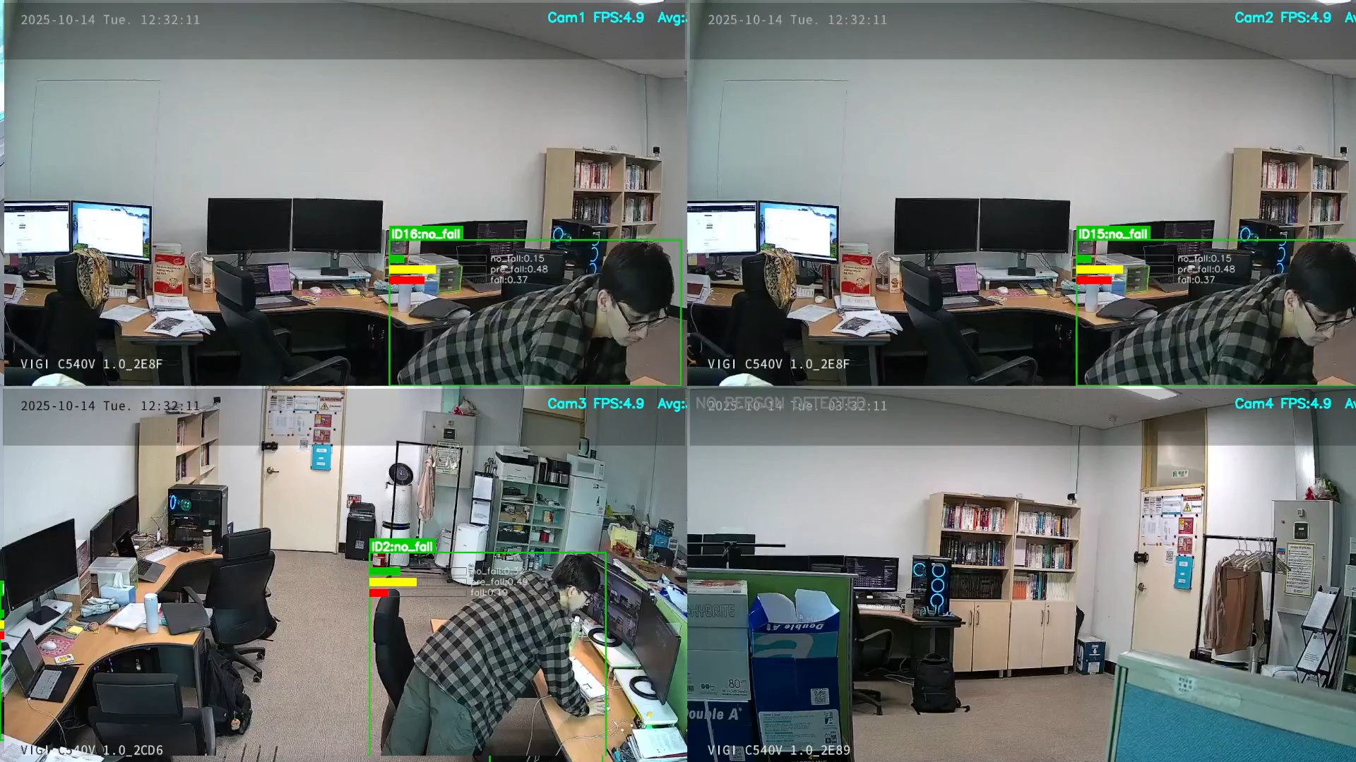
DEMO – Test Multicamera
5~ FPS, freezing, lag

Slide 37
Problem – Before Optimization
With 4 cameras (previous system):
Severe lag issues
Streams couldn’t catch up to real-time
Low FPS: 6~7 FPS per camera
Cameras froze and shut down unexpectedly

Slide 38
Our Optimization Solution
We introduced the following solutions:
Multi-threading – Separate thread per camera
Frame skipping – Skip stale frames under lag
Batch inference – Feed 4 frames simultaneously to model
Buffer optimization – Only essential data kept
Unified 2x2 grid UI – 4 camera streams in one window

Slide 39
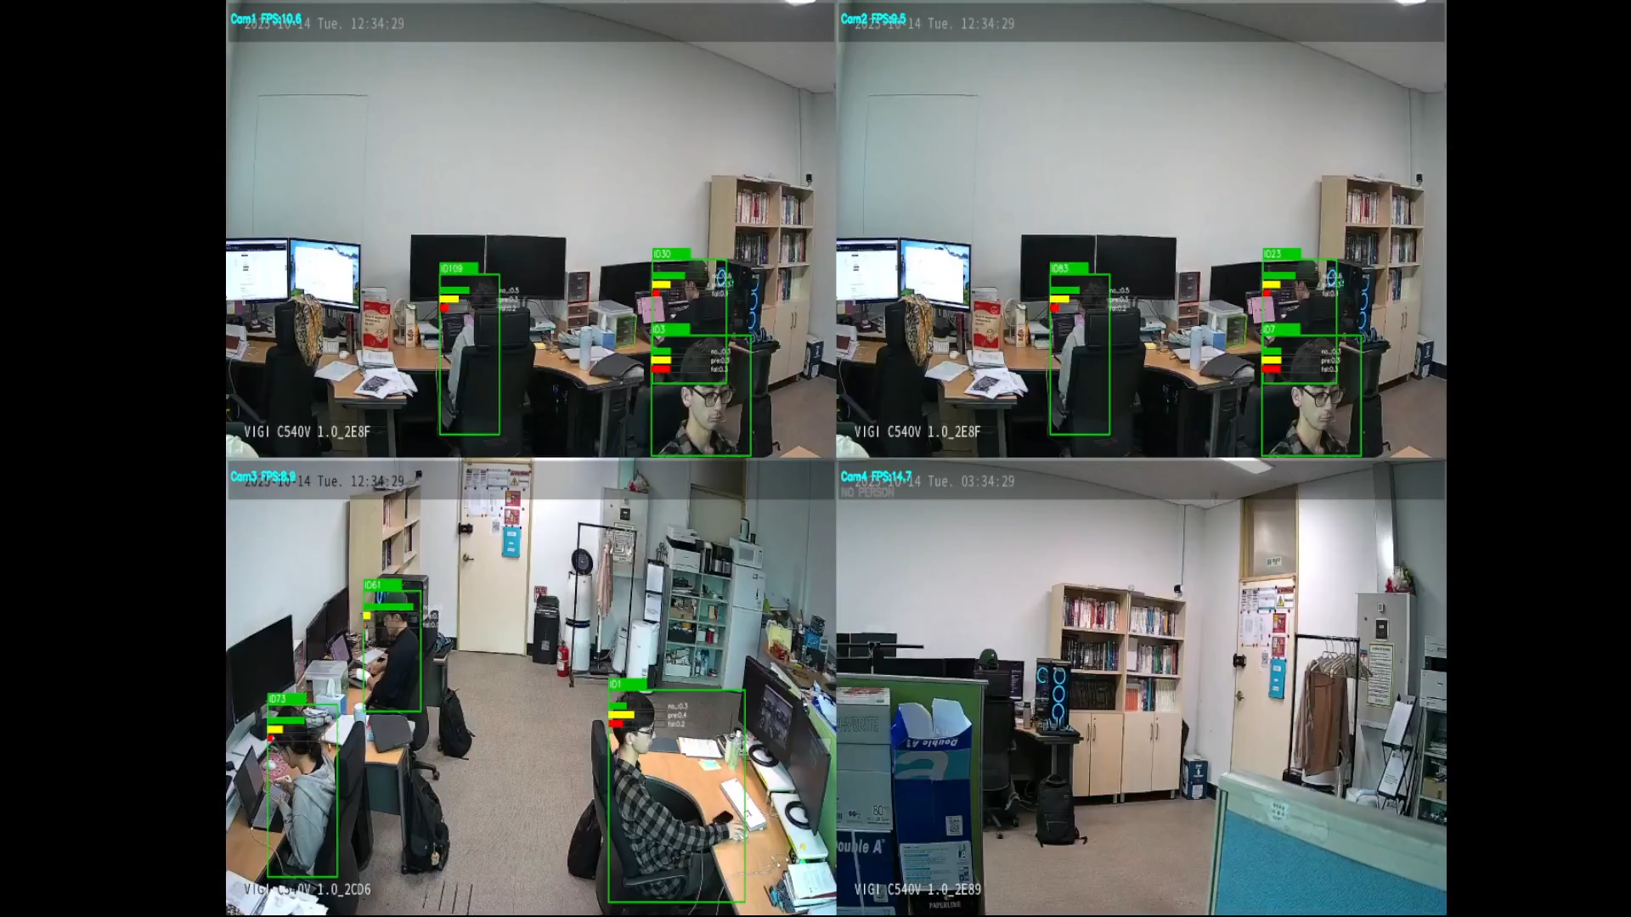
DEMO (After Optimzation)
11~ FPS per camera, smooth real-time

Slide 40
Progress Presentation Integration
Abbos Aliboev

Slide 41
Fall Detection Integration
Real-time fall detection module successfully added
Integrated with existing PPE, Fire, and Danger-Zone systems
Works on 6 CCTV cameras simultaneously
System
PPE Detection
Fall Detection
Fire Detection
Danger-Zone

Slide 42
Integration & Real-Time Visualization
Added fall_results to global camera_results (shared memory)
New backend API endpoint → / api / fall / status
Frontend auto-updates “Danger” status dynamically
Fully synchronized with PPE, Fire, and Danger-Zone modules
Live alerts refresh within 1 second

Slide 43
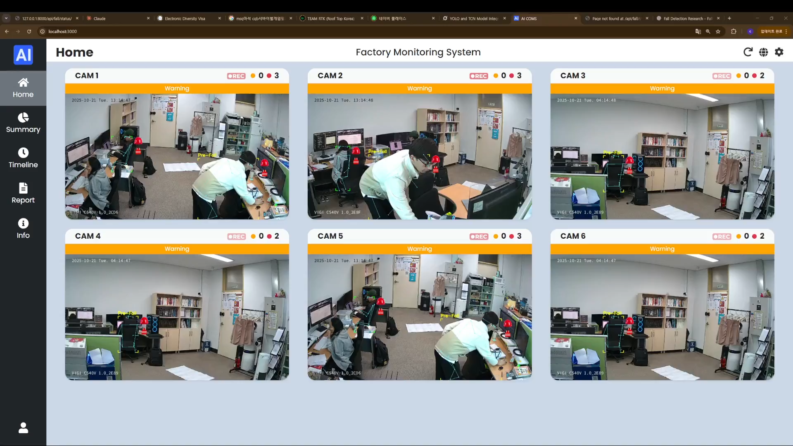
System Demo
Real-time fall detection on all 6 cameras Integrated alerts across the system
RTSP Avg FPS
per camera 11.33

Slide 44
Thanks!
Do you have any questions?
www.abbosaliboev.site

